Slide 1
Café Athena vs.
Pacific Beach competitors
VISIBILITY REPORT
Benchmark: Café Athena, Pacific Beach, San Diego
Competitors: JRDN, Slowly, Spitz and Waterbar. Research date: October 23, 2026.
Group: Clara,Kanokkan, Erica, Wes
Notes:
Report compares Café Athena with four Pacific Beach competitors using AI search tests on ChatGPT and Claude, website research and public Google business information.

Slide 2
Café Athena has a solid base in AI recommendations
EXECUTIVE SUMMARY
50%
2nd of 5
3 gaps
Café Athena’s combined mention rate across 10 AI responses.
Slowly leads at 60%. JRDN and Spitz follow at 30% each, Waterbar at 10%.
Occasion content, group-event details and consistent third-party listings.
Five queries tested on ChatGPT and Claude, October 23, 2026.

Slide 3
Café Athena ranks second in AI restaurant mentions
AI SEARCH VISIBILITY
Slowly
60%
Café Athena by platform
60%
Café Athena
50%
JRDN
30%
ChatGPT
40%
Spitz
30%
Waterbar
10%
Claude
Combined mention rate across 5 queries on ChatGPT and Claude, 10 responses. Tested October 23, 2026.
Notes:
Slowly leads at 6 of 10 responses; Café Athena appears in 5 of 10. Café Athena performs better on ChatGPT (3/5) than Claude (2/5). Results cover only the selected queries and platforms.

Slide 4
Slowly holds the largest share of voice
SHARE OF VOICE AND RANK
Restaurant | Mentions | Share of voice
Slowly | 6 | 33.3%
Café Athena | 5 | 27.8%
JRDN | 3 | 16.7%
Spitz | 3 | 16.7%
Waterbar | 1 | 5.6%
Café Athena rank
ChatGPT: #1 in all three ranked lists
Claude: #1 and #3
Share is among the five selected restaurants, based on 18 confirmed mentions. Unranked searches excluded.

Slide 5
Competitors win by being specific
COMPETITOR GAP ANALYSIS
JRDN: occasions
Slowly: detail
Oceanfront and celebration content, with published event capacity of 15–150 guests.
Date-night specials, Aperitivo, FAQs and private dining by group size.
Spitz: local SEO
Waterbar: experience
A dedicated Pacific Beach page with hours, ordering, catering and amenities.
Beachfront views, seafood, cocktails and prominent happy-hour messaging.
These are possible advantages. The report does not show they caused the AI results.

Slide 6
Review volume does not predict AI mentions
GOOGLE BUSINESS PROFILE
Restaurant | Rating | Reviews | Category
Café Athena | 4.6 | 545 | Mediterranean
JRDN | 4.4 | ~1,600 | Seafood
Slowly | 4.5 | 126 | Mediterranean
Spitz | 4.9 | 412 | Mediterranean
Waterbar | 4.3 | 2,515 | American
Waterbar has 2,515 reviews but the lowest mention rate (10%). Snapshot dates may differ; verify before citing.

Slide 7
Three steps to win more AI recommendations
PRIORITY ACTIONS
1
2
3
Detail group dining and events
Write for dining occasions
Measure on a regular schedule
Publish capacity, group menus and celebration packages, as JRDN and Slowly already do.
Add date night, happy hour and group dinner content. Slowly leads the test at 60%.
Repeat the same five queries and track mention rate, rank and share-of-voice.
Source: Café Athena AI Search Visibility Report, P1 actions.
Notes:
The three P1 actions from the report. Visibility differs between ChatGPT and Claude, so track both. Impact should be tested after implementation, not assumed.

Slide 8
Ready-to-use content for Café Athena
OPTIMIZATION ARTIFACTS
Website copy
FAQ content
Structured data
A page on Greek and Mediterranean dining in Pacific Beach, covering lunch, dinner and group celebrations.
Five answers: cuisine, vegetarian, gluten-free, happy hour and group celebrations.
Restaurant JSON-LD with verified name, address, phone, hours and menu URL.
Check dietary and event details with the restaurant, and validate markup before publishing.

Slide 9
Four weeks from audit to re-test
IMPLEMENTATION
Week 1
Week 2
Week 3
Week 4
Complete the baseline and third-party audit.
Improve website descriptions and FAQs.
Update listings and review technical SEO.
Repeat the original queries for a before-and-after scorecard.
Use the same queries, platforms and criteria. Measure mention rate, rank and share of voice.

Slide 10
Café Athena’s strengths need to be easier to find
CONCLUSION
Slowly leads at 60% and Café Athena follows at 50%.
The main gap is how clearly services are communicated, not what is offered.
Re-test with the same queries before claiming results.
Findings are limited to the selected queries, platforms and public evidence.

Slide 11
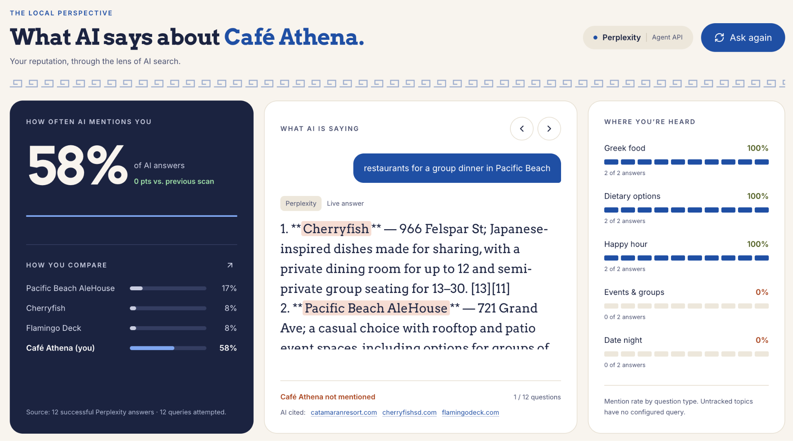
How KLEOS helps.
KLEO generates a complete AISO report, and spots the problem
E.g not showing up on date night searches

Slide 12
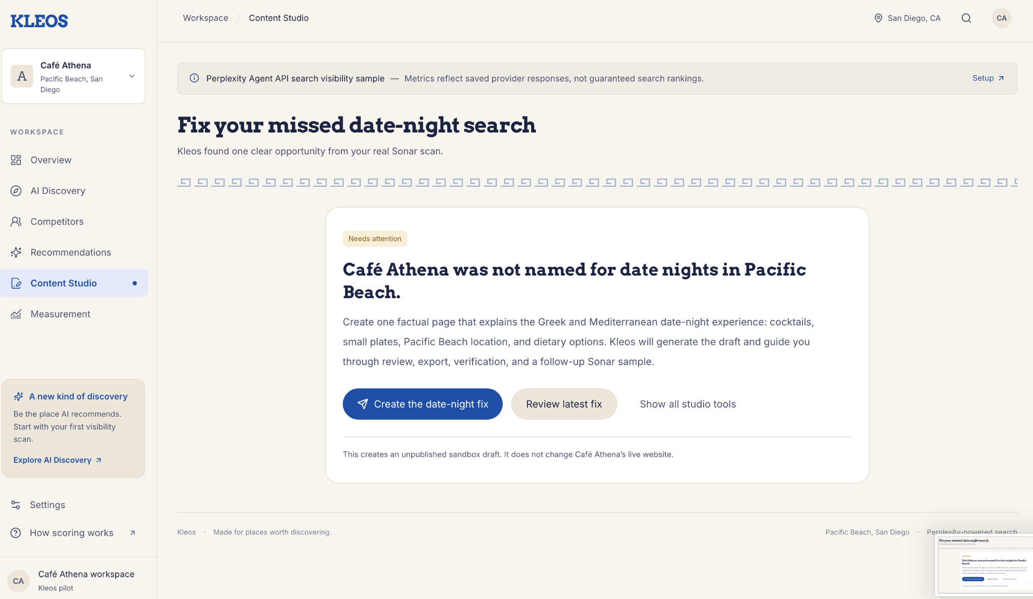
KLEOS Spots the problem & recommends a fix

Slide 13
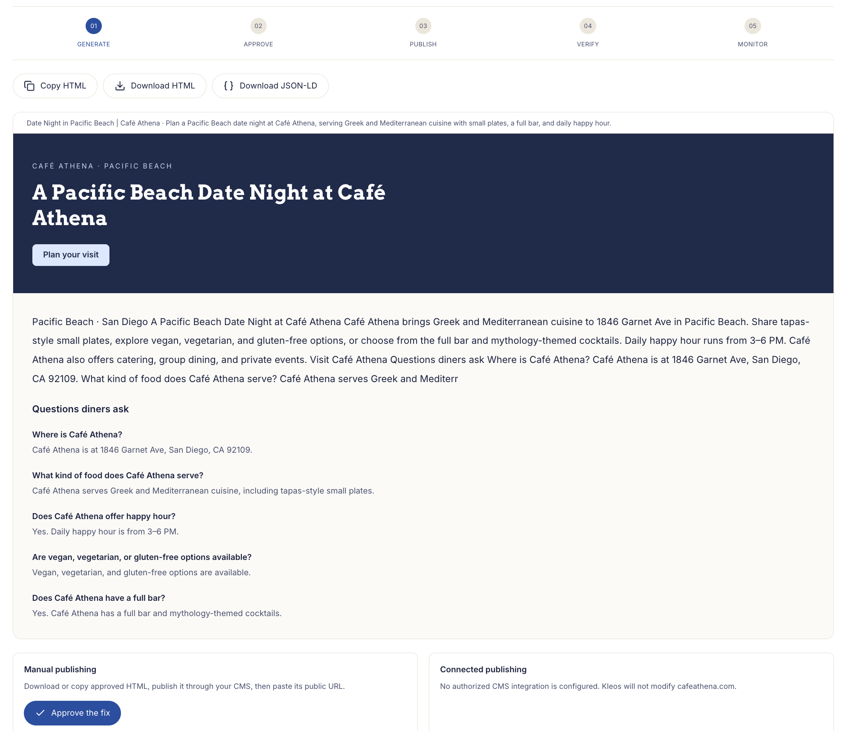
KLEOS suggests to add copy to landing page
KLEO generates a complete copy with keywords that matter.

Slide 14
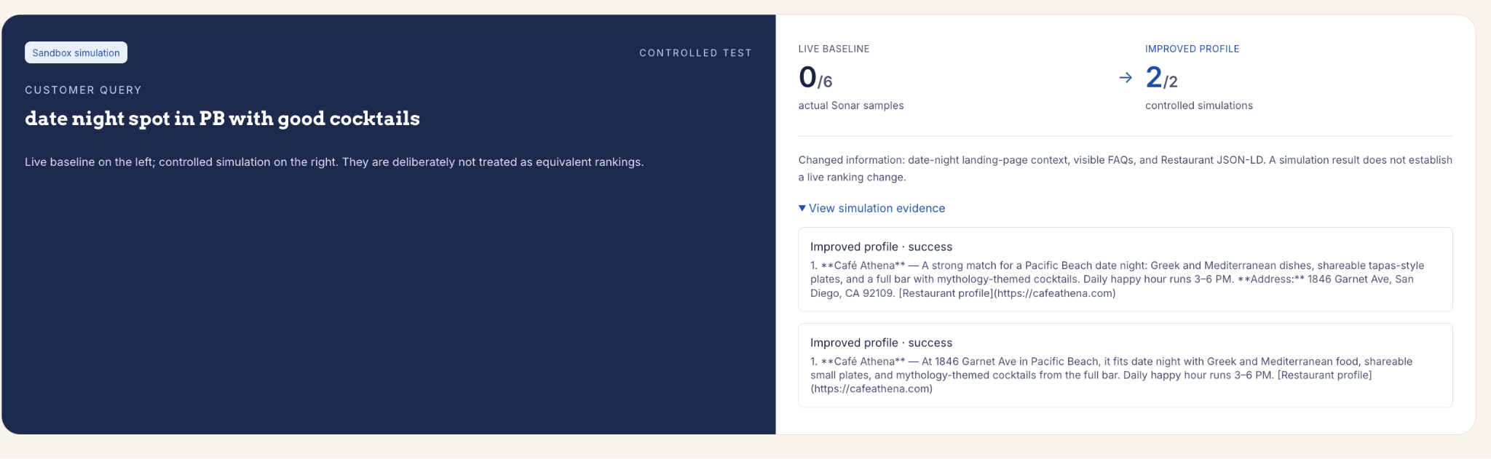
KLEOS creates a sandbox to simulate and test AI visibility improvements.

Slide 15
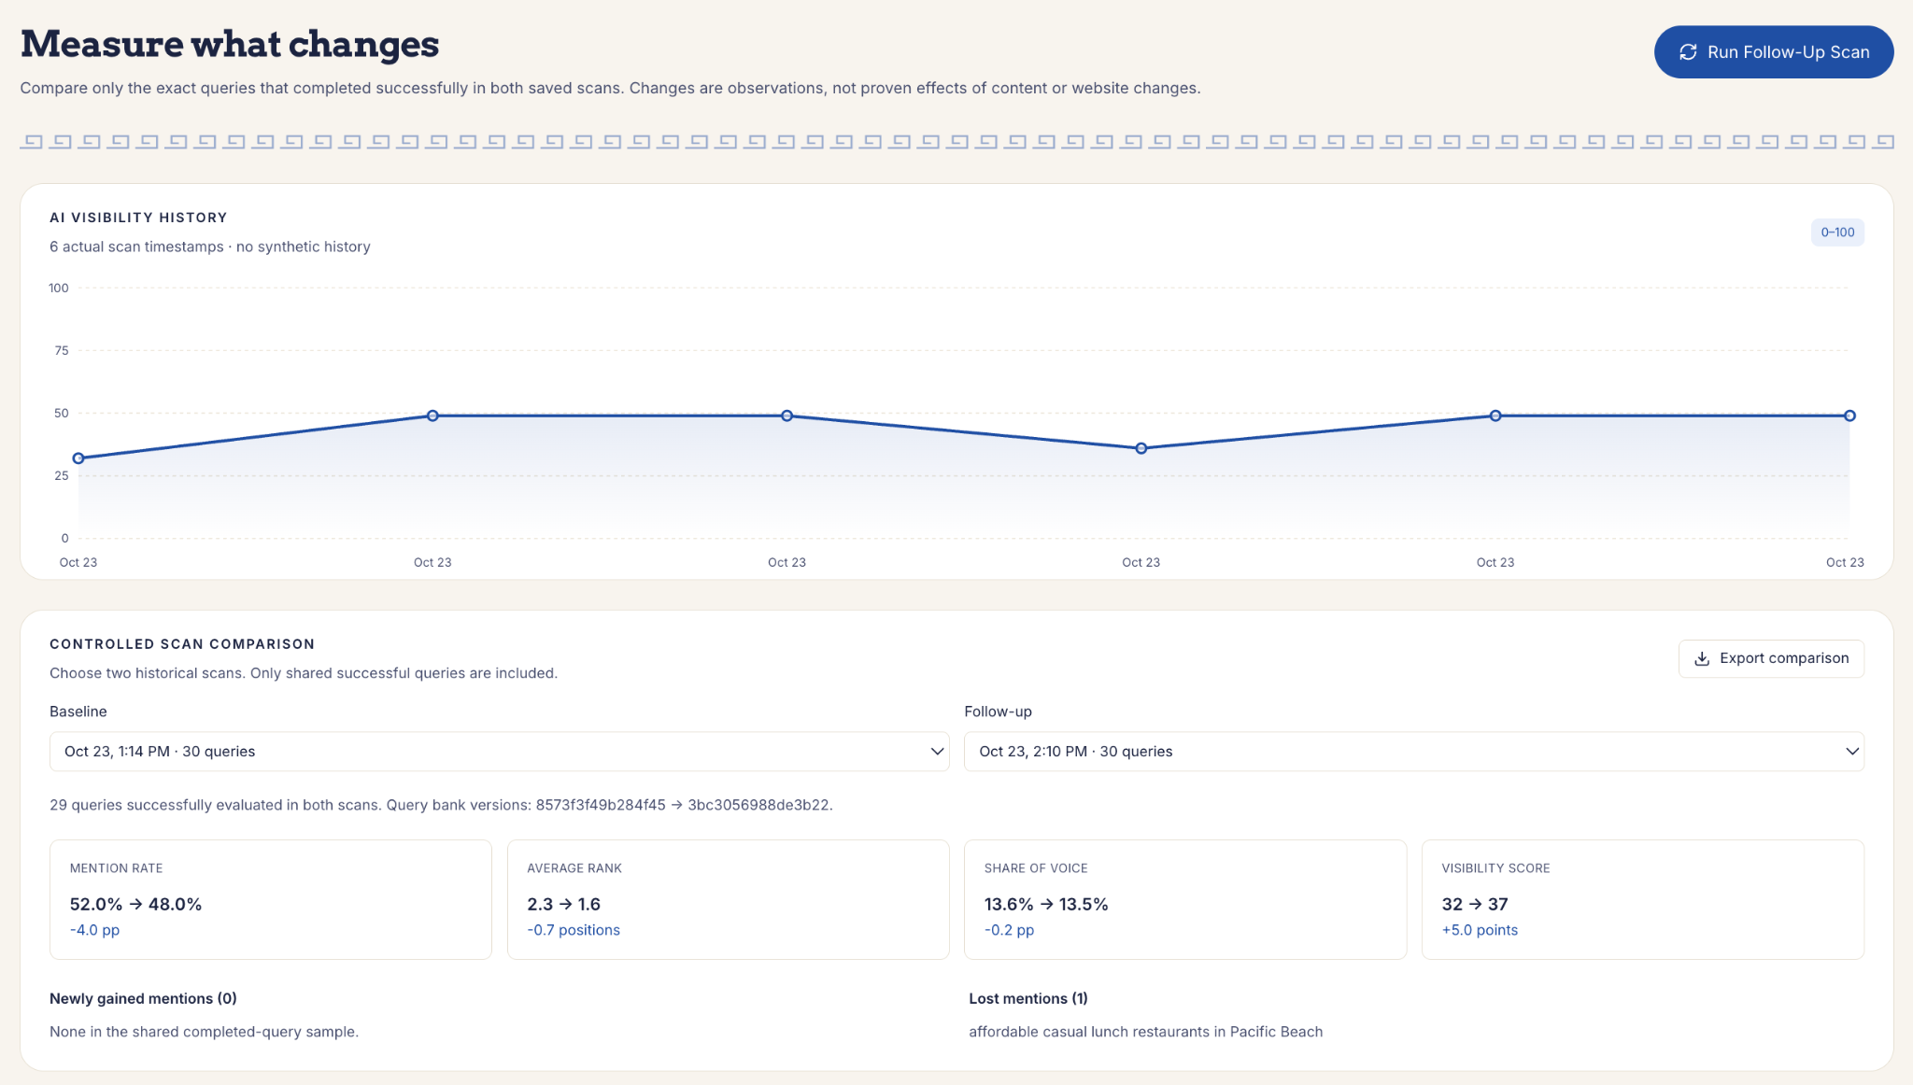
KLEOS tracks the metrics over time.

